Slide 1
Emergency Department Drug Abuse Visits
Laura Eshee
Capstone Project 1

Slide 2
Background
Addiction is a chronic disease characterized by drug seeking and use that is compulsive, or difficult to control, despite harmful consequences.
Drug abuse occurs when a person takes a substance, whether illegal, prescribed or over the counter, for purposes other than those in which they are meant to be used, or when a person takes large quantities of the substance.
Typically, the person is using the drug to alter his or her mood or feel better and not for a health reason.

Slide 3
Statistics
Almost 21 million Americans have at least one addiction, yet only 10% of them receive treatment.²
Drug overdose deaths have more than tripled since 1990.²
From 1999 to 2017, more than 700,000 Americans died from overdosing on a drug.²
More than 90% of people who have an addiction started to drink alcohol or use drugs before they were 18 years old.²
Americans between the ages of 18 and 25 are most likely to use addictive drugs.²
Alcohol and drug addiction cost the U.S. economy over $600 billion every year.²
During 2008–2011, an average of 1.1 million emergency department (ED) visits were made each year for drug poisoning, with a visit rate of 35.4 per 10,000 persons.³
About one-quarter (24.5%) of drug-poisoning ED visits resulted in hospital admission.³

Slide 4
Problem Statement
Emergency Departments need to be prepared to deal with drug abuse cases
Expected types and percentages of drug abuse related visits
Staffing, medications, supplies

Slide 5
Data Set
Drug Abuse Warning Network (DAWN)
A public health surveillance system that monitors drug abuse related visits to emergency departments in hospitals in large metro areas across the US
Monitors trends in drug misuse and abuse
Identifies the emergence of new substances and drug combinations
Estimates the impact of drug misuse and abuse on the Nation’s health care system

Slide 6
Data Set
DAWN 2011 Data Set includes:
Demographics
Drugs involved (up to 22 in a case)
Toxicology confirmation
Route of administration
Type of case
Disposition of patient
Website: https://www.datafiles.samhsa.gov/study-dataset/drug-abuse-warning-network-2011-dawn-2011-ds0001-nid13747

Slide 7
Data Set Preparation (Data Wrangling)

Slide 8
Size and Columns
The data set was examined to see its size and column names
229,221 rows
284 columns
It was decided to remove the ‘sdled’ and ‘CATID’ columns since their inclusion is beyond the scope of this project
Reduced data set has 84 columns

Slide 9
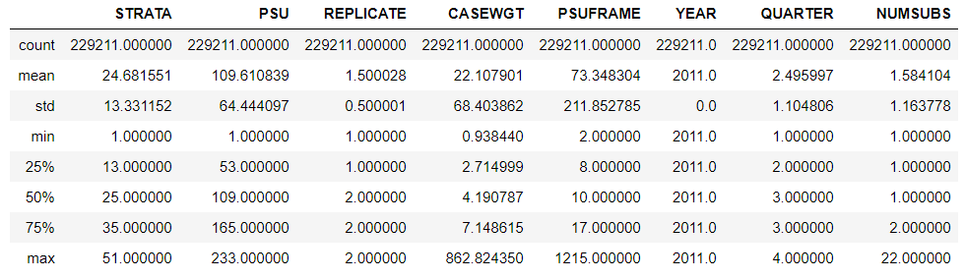
Descriptive Statistics

Slide 10
Unique Values
Feature | Count
CASEWGT | 2,931
DRUGID_1 | 1,604
DRUGID_2 | 1,074
… | …
ALLABUSE | 2
YEAR | 1

Slide 11
Other Attributes
Most of the variables are categorical—they can be divided into groups. Examples include race, gender, age group
No missing values

Slide 12
Data Story

Slide 13
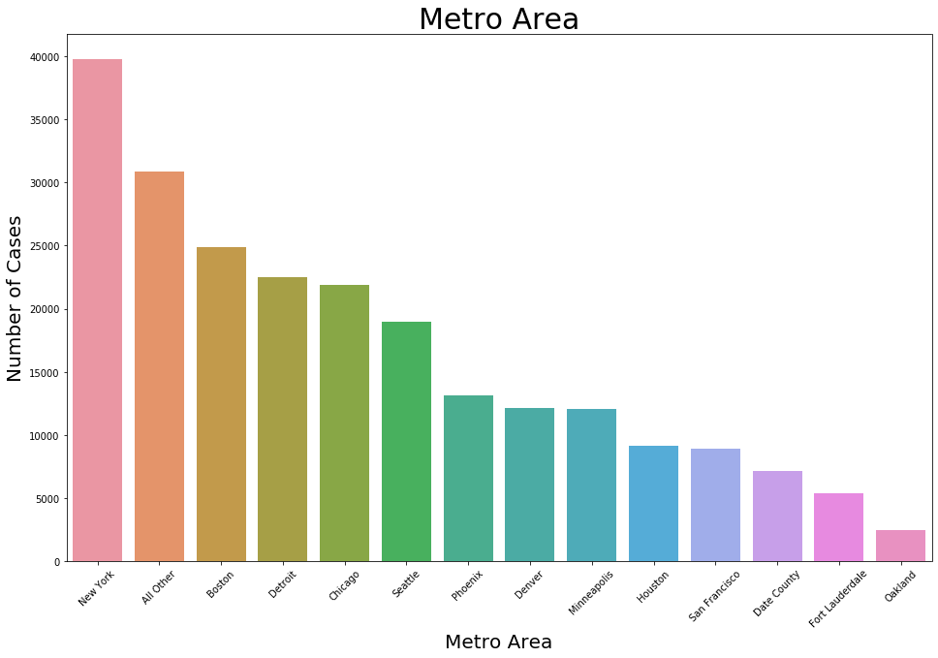

Slide 14
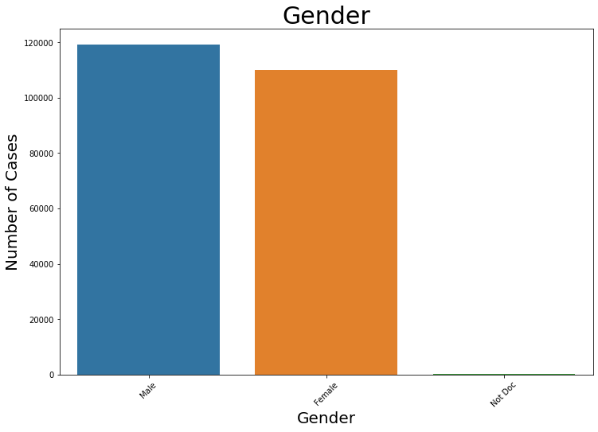

Slide 15
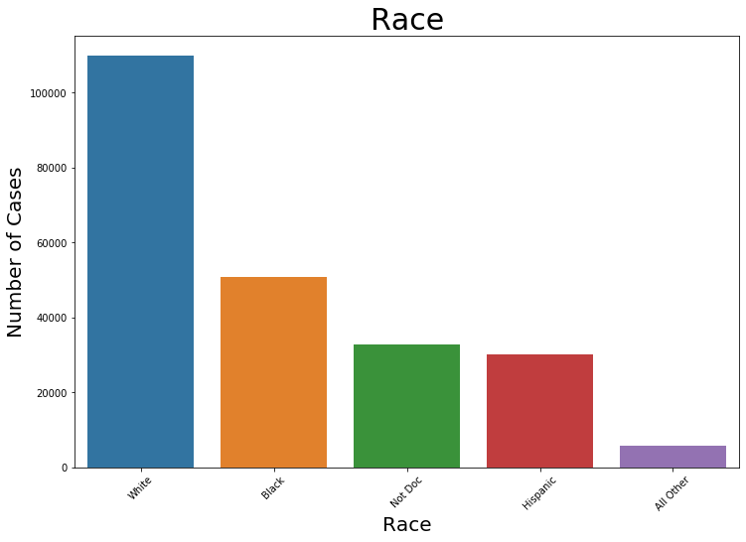

Slide 16
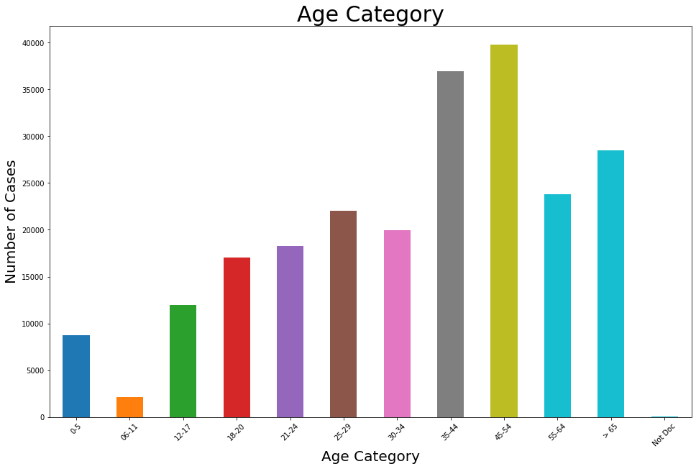

Slide 17
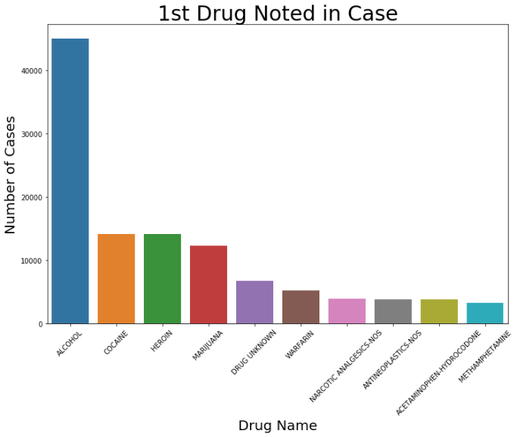
Notes:
When plotting the distribution of the Drug(s) involved in the cases, it was decided to show only top 10 since there are > 2600 drugs possible. Otherwise, the graph would be too large and hard to read.
Also, there were up to 22 substances involved in one case, and a plot was done for each instance. However, I’m not going to bore you by showing all of them—just the 1st 2.
One thing that interested me was whether or not the instances of hydrocodone were large, since we hear so much about it in the news. In the 1st graph, you can see that it’s the 2nd to last one. So, while it is in the top 10, it’s way behind alcohol, cocaine and heroin.

Slide 18
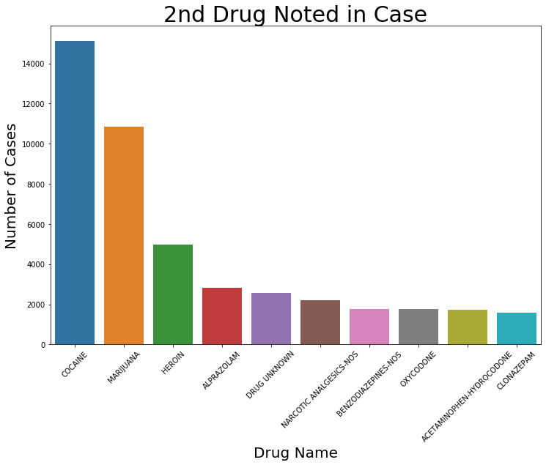

Slide 19
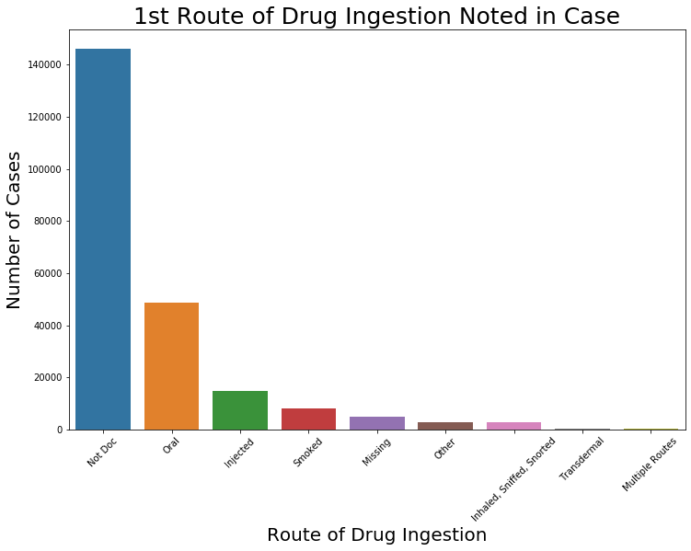

Slide 20
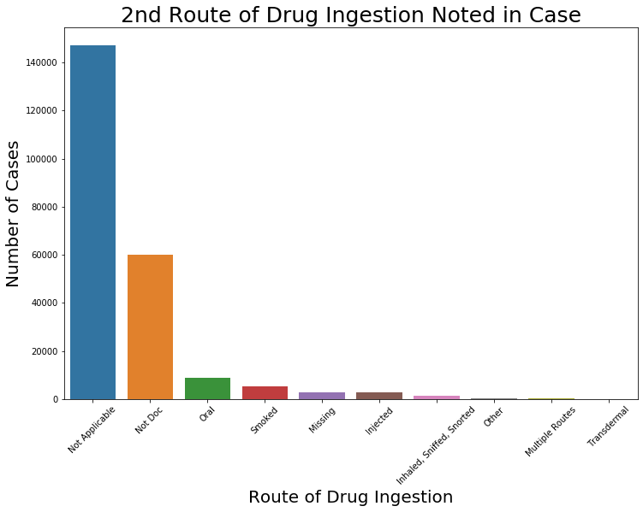

Slide 21
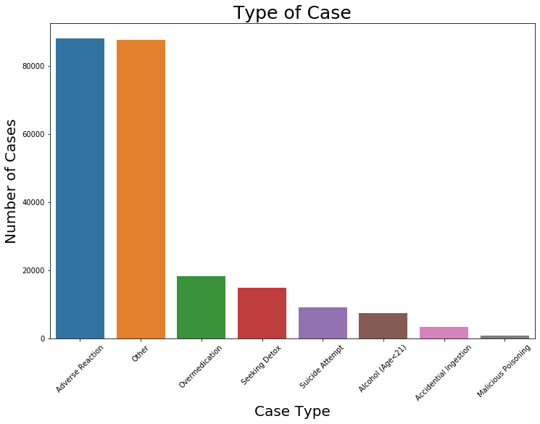

Slide 22
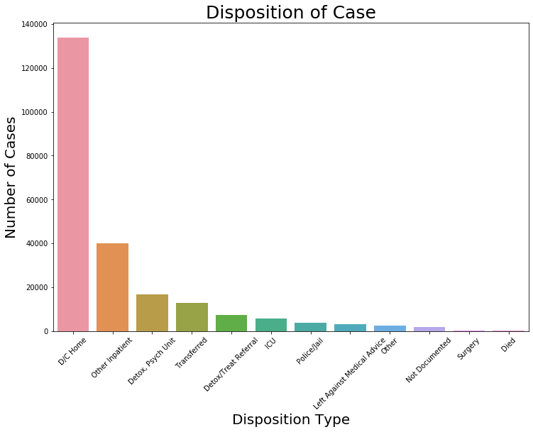

Slide 23
Data Story Summary
The time of year is evenly distributed.
The time of day that most cases occur is between 12:00 pm - 11:59 pm.
Alcohol, cocaine, heroin and marijuana are involved in many of the cases.
Most of the drugs were taken orally.
Most were not confirmed by a toxicology test.
Most of the cases were due to adverse reactions to the drugs.
Most cases were discharged home.
Most of the drugs involved were pharmaceutical.

Slide 24
Inferential Statistics

Slide 25
Is there a significant difference in the frequency of cases in each of the cities?
H_{o}: p1 = p2... = p15
H_{a}: p1 != p2... != p15
The p-value was 0.0; therefore, H_{o} was rejected. It is reasonable to conclude that the distribution of the proportion of the location of the cases is not equal.

Slide 26
Does the race of the patient vary significantly?
H_{o}: p1 = p2... = p15
H_{a}: p1 != p2... != p15
The p-value was 0.0; therefore, H_{o} was rejected. It is reasonable to conclude that the distribution of the proportion of race is not equal.

Slide 27
Are the disposition of the case and the case type independent of each other?
H_{o}: the population frequencies are equal to the expected frequencies
H_{a}: the population frequencies are not equal to the expected frequencies.
The p-value was 0.0; therefore, H_{o} was rejected. It is reasonable to conclude that the distribution of population frequencies are not equal to the expected frequencies.

Slide 28
Modeling

Slide 29
Logistic Regression Full Data Set
Class | Precision | Recall | F1-score | Support
Accidental Ingestion | 0.88 | 0.01 | 0.02 | 1,301
Adverse Reaction | 0.92 | 0.99 | 0.95 | 35,239
Alcohol (Age<21) | 0.99 | 1.00 | 1.00 | 2,968
Malicious Poisoning | 0.50 | 0.01 | 0.02 | 317
Other | 0.87 | 0.93 | 0.90 | 35,051
Overmedication | 0.74 | 0.72 | 0.73 | 7,259
Seeking Detox | 0.77 | 0.51 | 0.61 | 5,937
Suicide Attempt | 0.74 | 0.46 | 0.57 | 3,613

Slide 30
Logistic Regression Reduced Data Set
Class | Precision | Recall | F1-score | Support
Accidental Ingestion | 0.22 | 0.68 | 0.33 | 814
Adverse Reaction | 0.97 | 0.84 | 0.90 | 22,024
Alcohol (Age<21) | 0.99 | 1.00 | 1.00 | 1,855
Malicious Poisoning | 0.09 | 0.75 | 0.16 | 198
Other | 0.95 | 0.65 | 0.77 | 21,907
Overmedication | 0.47 | 0.75 | 0.58 | 3,710
Seeking Detox | 0.47 | 0.75 | 0.58 | 3,710
Suicide Attempt | 0.47 | 0.72 | 0.57 | 2,258

Slide 31
Random Forest Reduced Data Set
Class | Precision | Recall | F1-score | Support
Accidental Ingestion | 0.82 | 0.04 | 0.08 | 814
Adverse Reaction | 0.90 | 0.99 | 0.94 | 22,024
Alcohol (Age<21) | 0.99 | 1.00 | 1.00 | 1,855
Malicious Poisoning | 0.84 | 0.27 | 0.41 | 198
Other | 0.84 | 0.93 | 0.89 | 21,907
Overmedication | 0.71 | 0.66 | 0.68 | 4,537
Seeking Detox | 0.80 | 0.44 | 0.57 | 3,710
Suicide Attempt | 0.73 | 0.24 | 0.36 | 2,258

Slide 32
Random Forest Reduced Data Set—Hyperparameter Tuning
Class | Precision | Recall | F1-score | Support
Accidental Ingestion | 0.22 | 0.30 | 0.25 | 814
Adverse Reaction | 0.92 | 0.92 | 0.92 | 22,024
Alcohol (Age<21) | 0.99 | 1.00 | 1.00 | 1,855
Malicious Poisoning | 0.18 | 0.40 | 0.25 | 198
Other | 0.91 | 0.75 | 0.82 | 21,907
Overmedication | 0.53 | 0.94 | 0.67 | 4,537
Seeking Detox | 0.57 | 0.60 | 0.59 | 3,710
Suicide Attempt | 0.48 | 0.39 | 0.43 | 2,258

Slide 33
Precision Scores for Each Model

Slide 34
Questions?

